Slide 1
Class presentation: Unit 12
Methodology
Comparisons
14 October 2014
Dr. D de Villiers

Slide 2
Criteria for assessing methodologies
Rules
Total coverage
Understanding the information resource
Documentation standards
Separation of logical and physical designs
Validity of design
Early change
Inter-stage communication
Effective problem analysis
Planning and control

Slide 3
Criteria for assessing methodologies
Performance evaluation
Increased productivity
Improved quality
Visibility of the product
Teachable
Information systems boundary
Designing for change
Effective communication
Simplicity
Ongoing relevance
Automated development aids

Slide 4
Criteria for assessing methodologies
Consideration of user goals and objectives
Participation
Relevance to practitioner
Relevance to application
The integration of the technical and the non-technical systems
Scan for opportunity
Separation of analysis and design

Slide 5
Comparisons
1. What aspects of the development process does the methodology cover?
2. What overall framework or model does it utilize? For example, is it systems development life cycle based, linear, or spiral?
3. What representation, abstractions, and models are employed?
4. What tools and techniques are used?
5. Is the content of the methodology well defined and described, such that a developer can understand and follow it? This applies not only to the stages and tasks but also to the philosophy and objectives of the methodology.
6. What is the focus of the methodology? Is it, for example, people-, data-, process-, and/or problem-oriented? Does it address organizational and strategic issues?
7. How are the results at each stage expressed?

Slide 6
Comparisons
8. What situations and types of application is it suited to?
9. Does it aim to be scientific, behavioural, systemic, or whatever?
10. Is a computer solution assumed? What other assumptions are made?
11. Who plays what roles? Does it assume professional developers, require a methodology facilitator, involve users and managers, and, if so, how and to what degree?
12. What particular skills are required of the participants?
13. How are conflicting views and findings handled?
14. What control features does it provide and how is success evaluated?
15. What claims does it make as to benefits? How are these claims substantiated?
16. What are the underlying philosophical assumptions of the methodology? What makes it a legitimate approach?

Slide 7
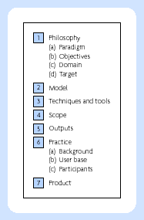
Framework for comparing methodologies – seven elements

Slide 8
Types of Model
Verbal
Analytic or mathematical
Iconic, pictorial, or schematic
Simulation

Slide 9
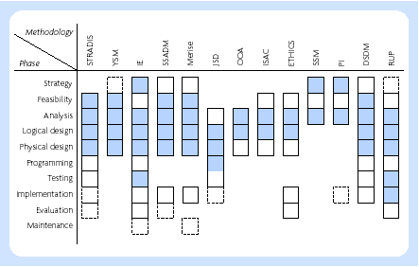
Scope of methodologies

